Slide 1
Exploratory Data Analysis (EDA)

Slide 2
Overview of the Topics
Introduction to EDA
Dataset Features
Data Munging
Descriptive Statistics
Data Transformations
Variable Selection Procedures

Slide 3
Introduction to Exploratory Data Analysis
The “law of the instrument” developed by Abraham Kaplan in 1964 and Abraham Maslow’s hammer in 1966 state: “If all you have is a hammer, everything looks like a nail.”

Slide 4
Introduction to Exploratory Data Analysis
The primary purpose for the EDA is to better understand the data we are using, how to transform the data, if necessary, and how to assess limitations and underlying assumptions inherent in the data structure.
Data scientists need to know how the various pieces of data fit together and nuances in the underlying structures in order to decide what the best approach to the modeling task.

Slide 5
Introduction to Exploratory Data Analysis
Here are some of the main reasons why we utilize EDA:
Detection of mistakes.
Preliminary selection of appropriate models and tools.
Determining relationships of the explanatory variables (independent).
Detecting the direction and size of relationships between variables.

Slide 6
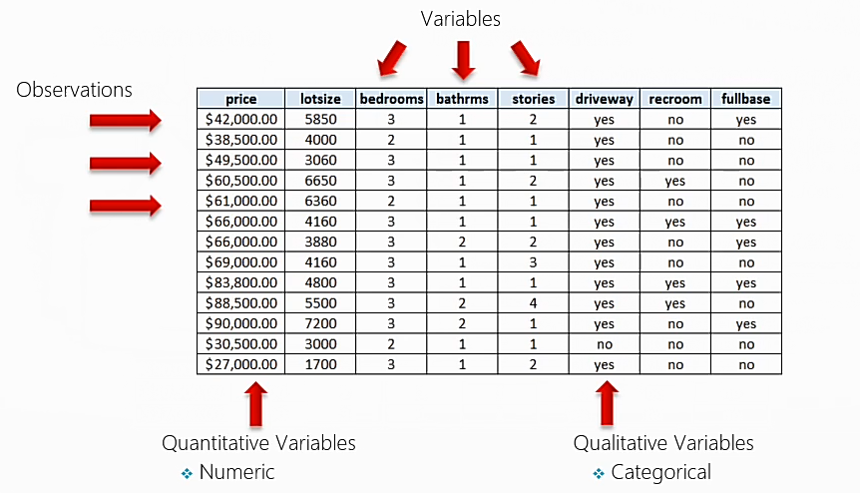
Features of a Data Set

Slide 7
Data Munging
Data Munging is the transformation of raw data to a useable format.
Many datasets are not readily available for analysis. Data needs to be transformed or cleaned first.
This process is often the most difficult and the most time consuming.

Slide 8
Data Munging Tasks
Renaming Variables
Data Type Conversion
Encoding, Decoding, recoding data.
Merging Datasets
Transforming Data
Handling Missing Data (Deletion and Imputation)
Handling Anomalous values
These data munging tasks are an iterate process and can occur at any stage throughout the overall EDA procedure.

Slide 9
Data Munging Tasks
Renaming Variables
Data Type Conversion
Encoding, Decoding, recoding data.
Merging Datasets
Transforming Data
Handling Missing Data (Deletion and Imputation)
Handling Anomalous values
These data munging tasks are an iterate process and can occur at any stage throughout the overall EDA procedure.

Slide 10
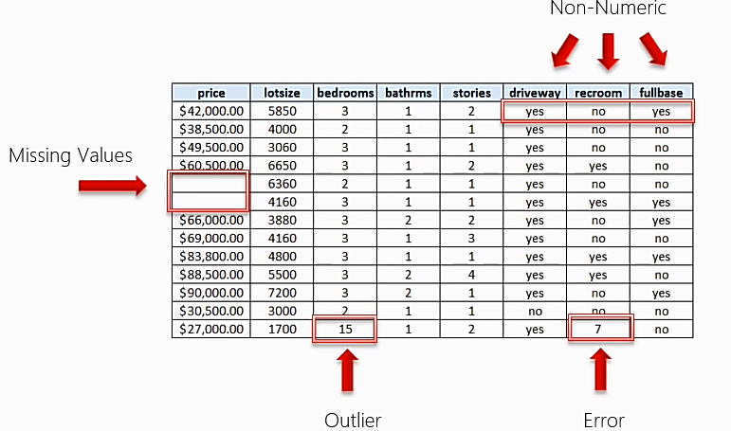
Understanding the Data

Slide 11
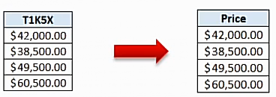
Data Munging Tasks
Renaming Variables
The names of variables should make intuitive sense to non-practitioners and does not have to conform to IT protocols and standards.

Slide 12
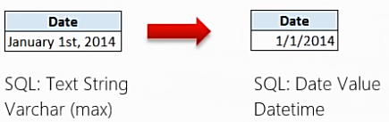
Data Munging Tasks
Data Type Conversion
Depending upon the modeling task at hand and the software, the data may need to be expressed in a specific
format in order to process correctly.

Slide 13
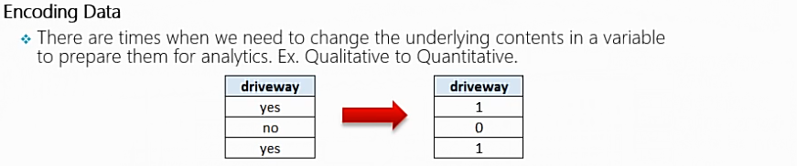
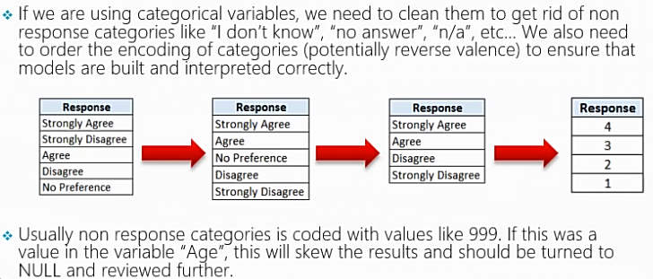
Data Munging Tasks

Slide 14
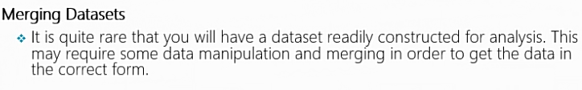
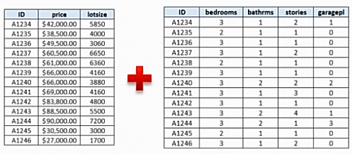
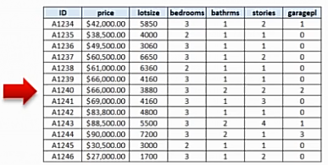
Data Munging Tasks

Slide 15
Data Munging Tasks
Data Transformation
Bucketing/Binning
Normalization
Other Mathematical Transformations: There may be times when a variable need to be transformed in order to achieve linearity.
Imputation
See previous lecture on data munging.
Notes:
Data Transformation and Feature Extraction as a Concept
The main purpose of data transformation and feature extraction is to enhance the data in such a way that it increases the likelihood that the classification algorithm will be able to make meaningful predictions. Unlike the steps taken during cleaning, which are designed to address problems with the raw data (missing and erroneous values, formatting issues etc.), these steps change the values and/or structure of the data (data transformation) and add additional features (feature extraction).
As you might imagine, this is quite an open-ended process, and hence a lot of the value that data scientists provide comes in these steps. There is no textbook or walkthrough that can tell you exactly what steps you should take for a given dataset, that knowledge can come only from experience, curiosity and trial and error. However, we can take a look at some common methods to provide a sense of what is possible. Please keep in mind this is not an exhaustive list of options.
Data Transformation
Covering steps taken to modify the data, data transformation is undertaken with the intention to enhance the ability of the classification algorithm to extract information from the data. Below are a few common data transformation methods used.
Bucketing/Binning
A common method for manipulating numeric data, binning or bucketing is when the numerical values in a particular column are converted from a continuous series into fixed ranges. For example, instead of using the age value of all our users, we could place them into buckets such as 15-20 years old, 21-25 years old and so on.
Typically this technique is used to manage ‘noisy data’. To understand what this means, think of the movements of the stock market over time: it goes up and down on an almost daily basis. However, if you are trying to predict the overall direction of the stock market over the next 6 months, these daily movements become kind of irrelevant – what you really want your model to focus on are the movements over longer periods of time. What is more, the essentially random daily movements in stock prices may actually confuse your prediction model – causing less accurate predictions. In this example, the daily movements are the noise and what you want to extract (the longer term direction of the market) is ‘the signal’.
The same logic can be applied to any numerical field in your dataset. If you are concerned that small changes in a given value may simply be representing random ‘noise’, you may want to consider bucketing/binning to remove that noise.
Normalization
Although normalization can take on a large number of meanings depending on the context, the type of normalization being referred to here is the statistical type – converting the values of a column into a ‘normalized’ range. This could be translating heights from centimeter values anywhere from 100cm to 220cm to a scale where 0 represents the average (mean) height for your dataset and -1/+1 represent one standard deviation from that average. It could be translating those heights into a range of values from 0 to 1, where 0 is the lowest value in your dataset and 1 is the maximum value. There is a number of other methods that can be used here as well.
This type of transformation is more important for certain types of algorithms than others. For some algorithms – like the one we will be using – this type of transformation is not typically necessary. But for other algorithms, the magnitude of the values in each column will impact the calculations. In these cases, it is optimal to convert (‘normalize’) the values in each column onto the same scale to ensure each column is treated the equally. For a more detailed explanation on this subject, this answer from Quora is a good place to start.
Other Mathematical Transformations
In a similar manner to normalization, there is an almost unlimited number of ways that the numerical values of a given column can be transformed such that they are more suitable for the algorithm being used.
To provide one example, arguably the most common transformation (other than normalization) is to use a logarithm function. This transformation is a commonly used method of dealing with exponential data series (i.e. a column where there a lot of low values and relatively few high values). For those wanting to understand this transformation better, the Wikipedia page on this topic has a great illustrated example.
As I am hemorrhaging readers at this point, I won’t go into detail on the various other transformations possible – the key point is to be aware that there is a large range of possibilities here depending on your needs.

Slide 16
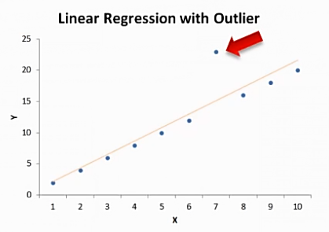
Data Munging Tasks
Handling Anomalous Values
Depending upon the analytic task, we need to assess points which exhibit a great deal of influence on the model.

Slide 17
Data Munging Tasks
Handling Anomalous Values
Outliers are data points that deviate significantly from the spread or distribution of other similar data points. These can typically be detected through the use of scatterplots.
Many times we will delete the entry with an outlier to achieve normality in the dataset. In some instances, an outlier can be imputed but this must be approached with caution.
Important: The drivers of outlying data points need to first be understood prior to devising an approach to dealing with them. They can hold the clues to new insights.

Slide 18
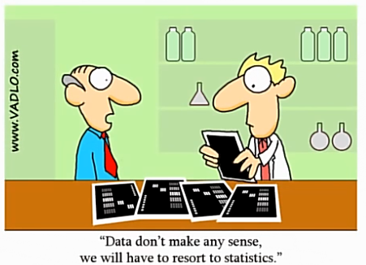
Descriptive Statistics
Describes the data in a qualitative
or quantitative manner.
Provides a summary of the shape of the data.
These statistics help us to understand when transformations, imputations, and removal of outliers are necessary prior to model building.

Slide 19
Descriptive Statistics
Descriptive Statistics are a collection of measurements of two things: Location and variability.
Location tells you of the central value of your variable (e.g., mean, median, mode).
Variability refers to the spread of the data from the center value (e.g., variance, standard deviation, range)
Statistics is essentially the study of what causes variability in the data.

Slide 20
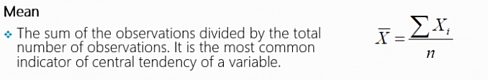
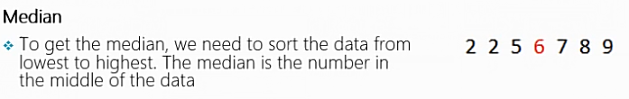

Descriptive Statistics - Location

Slide 21
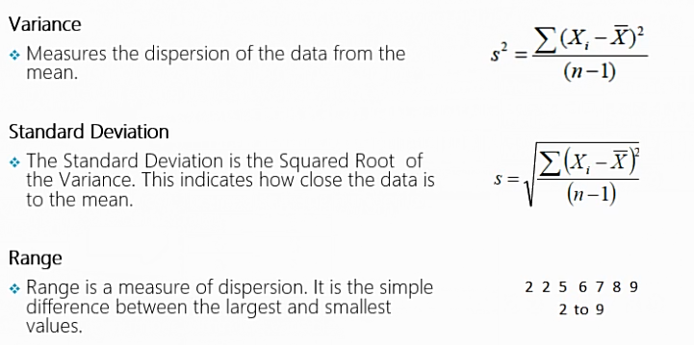
Descriptive Statistics - Variability

Slide 22
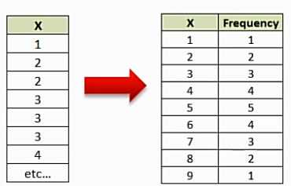
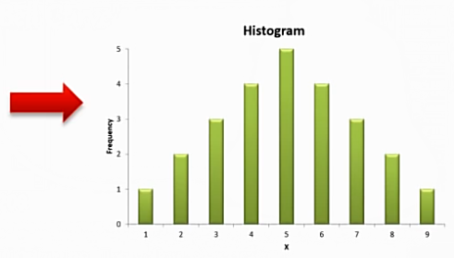
Histograms
Histograms are a graphical display of data using bars of different heights. This allows us to evaluate the shape of the underlying distribution. Essentially, a histogram is a bar chart that groups numbers into ranges or bins.

Slide 23
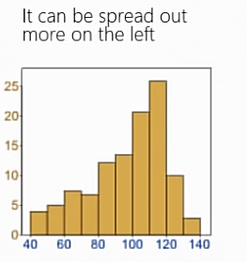
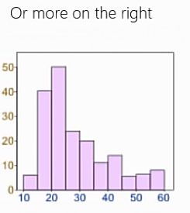
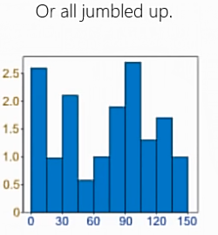
Histograms
Data can be distributed (spread out) in many different ways. It can be spread out more on the left Or more on the right Or all jumbled up.

Slide 24
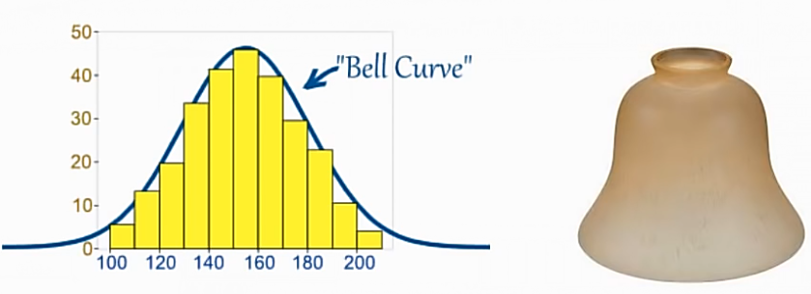
Normal Distribution
But there are many cases where the data tends to be around a central value with no bias left or right, and it gets close to a "Normal Distribution" like this:
The "Bell Curve" is a Normal Distribution. The yellow histogram shows some data that follows it closely, but not perfectly (which is usual).

Slide 25
Normal Distribution
Many things follow a normal distribution:
Height of People
Size of things produced by machines
Errors in measurements
Blood Pressure
Academic Test Scores

Slide 26
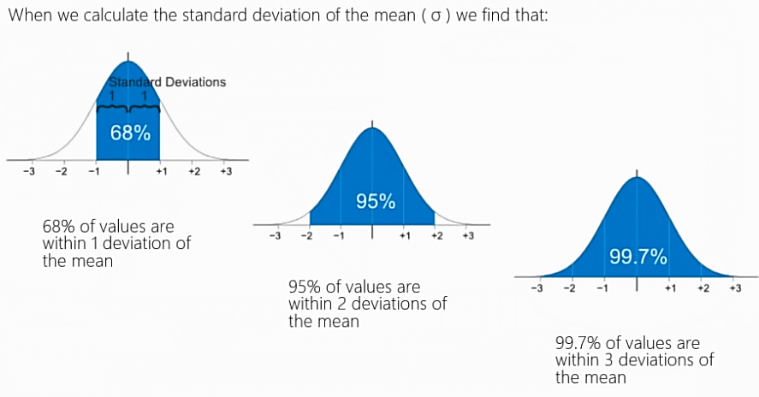
Normal Distribution

Slide 27
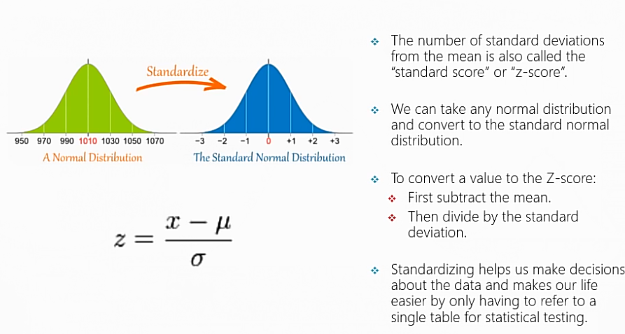
Normal Distribution

Slide 28
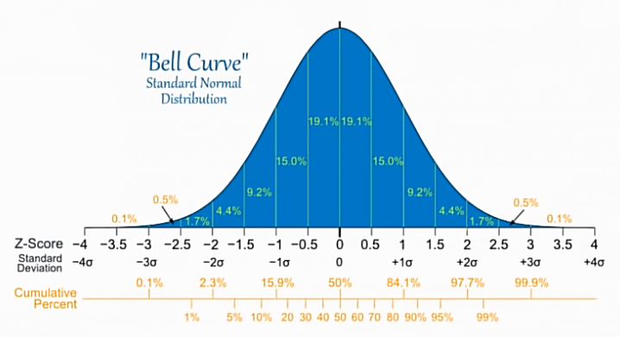
Normal Distribution
Here is the Standard Normal Distribution with percentages for every half of a standard deviation, and cumulative percentages:

Slide 29
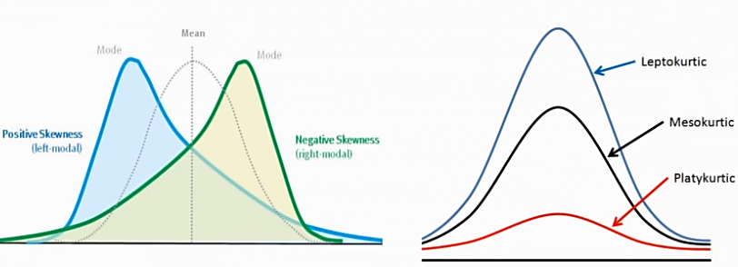
Normal Distribution
Skewness
A measure of asymmetry
Kurtosis
A measure of peakedness relative to a Guassian shape

Slide 30
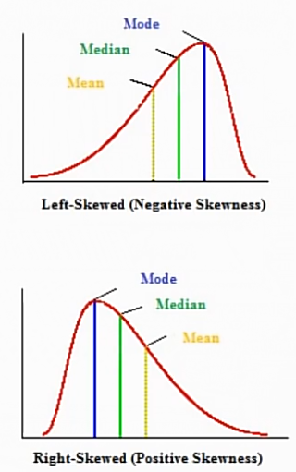
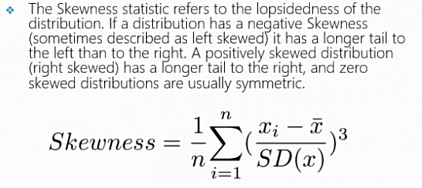
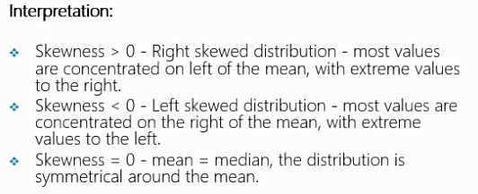
Normal Distribution

Slide 31
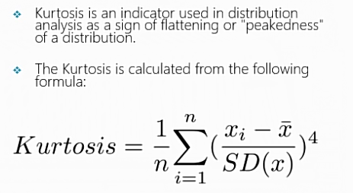
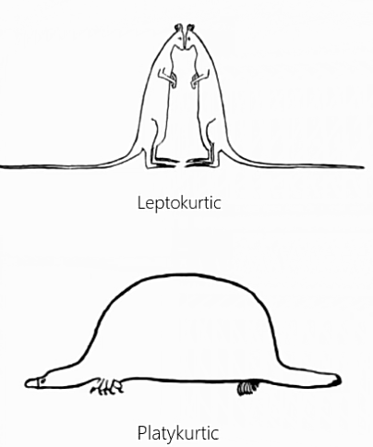
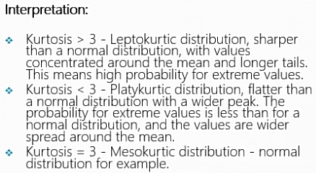
Normal Distribution

Slide 32
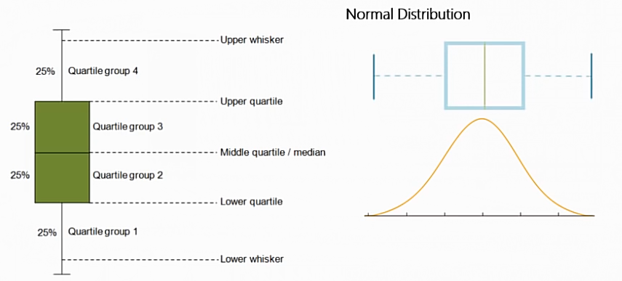
Box and Whisker Plot
A Boxplot is a nice way to graphically represent the data in order to communicate the data through their quartiles.
Notes:
The image above is a boxplot. A boxplot is a standardized way of displaying the distribution of data based on a five number summary (“minimum”, first quartile (Q1), median, third quartile (Q3), and “maximum”). It can tell you about your outliers and what their values are. It can also tell you if your data is symmetrical, how tightly your data is grouped, and if and how your data is skewed.

Slide 33
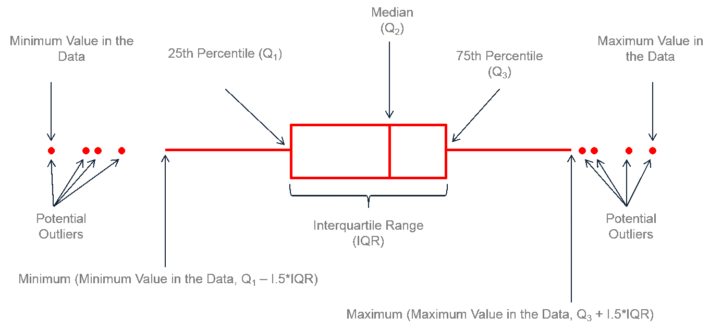
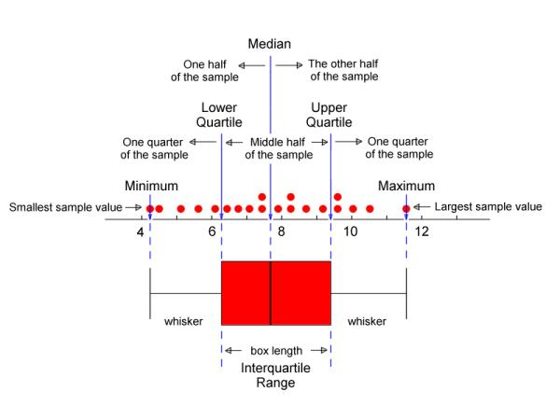
Box and Whisker Plot
Notes:
Boxplots are a standardized way of displaying the distribution of data based on a five number summary (“minimum”, first quartile (Q1), median, third quartile (Q3), and “maximum”).
https://towardsdatascience.com/understanding-boxplots-5e2df7bcbd51

Slide 34

Box and Whisker Plot Example
Example 1: Draw a box-and-whisker plot for the data set {3, 7, 8, 5, 12, 14, 21, 13, 18}.
Minimum: 3, Q₁ : 6, Median: 12, Q₃ : 16, and Maximum: 21.

Slide 35
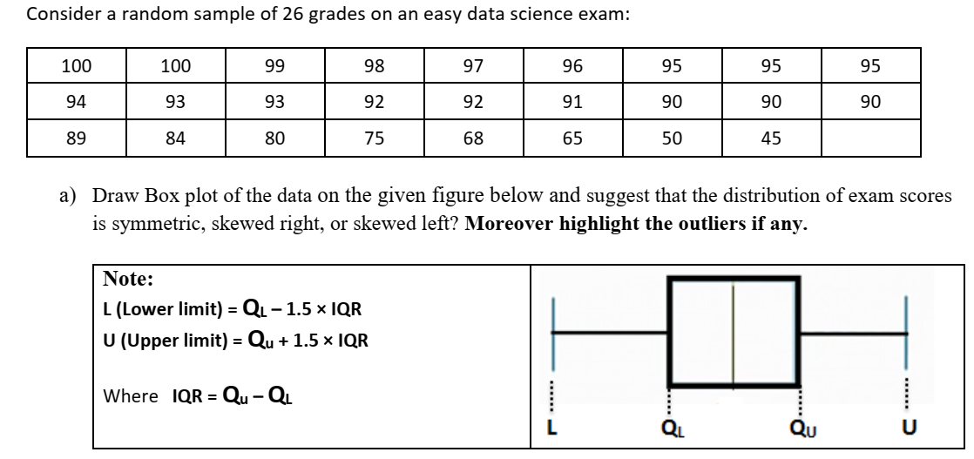
Task1: Box and Whisker Plot

Slide 36
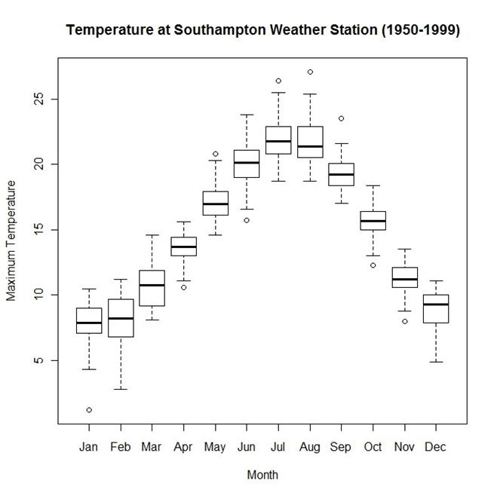
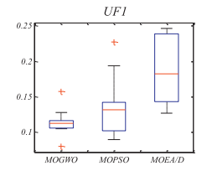
Box and Whisker Plot Examples

Slide 37
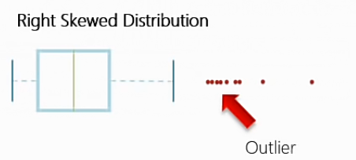
Box and Whisker Plot

Slide 38
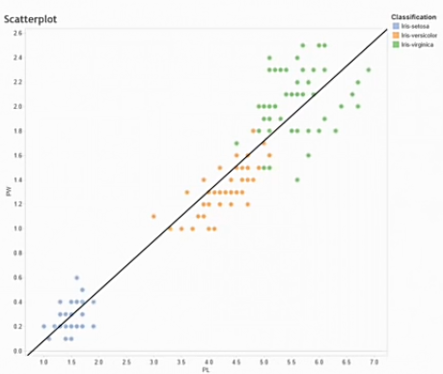
Scatterplots
A point plot between two variables used to understand the spread of the data.
The spread of the data allows
for us to understand if the data has
a non-linear or linear relationship
and the relative degree of the
correlation in the data.
This technique can allow be used to
detect outliers in the data.
A scatterplot becomes more powerful when
you incorporate categorical data as an
additional dimension..

Slide 39
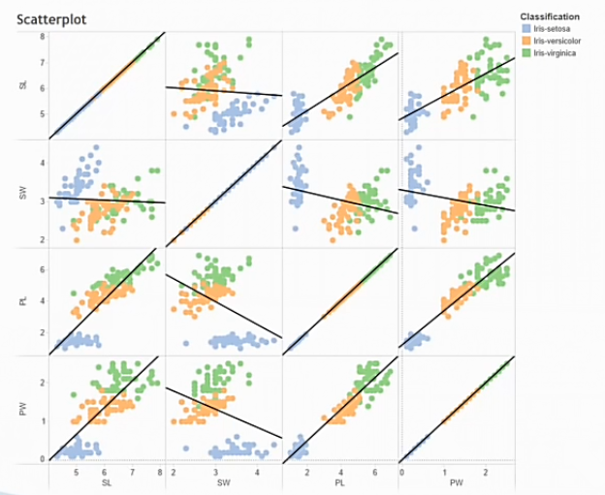
Scatterplots
Scatterplot Matrices can offer a view of the patterns within the data..

